Slide 1






Bootcamp
CV (Curriculum Vitae)
Session 8
Jeans Hernández
15/03/2024

Slide 2


Desarrollo Web Full Stack -
Avanzado
Módulo 1. Welcome / Famous People in IT
Módulo 2. Jobs in IT
Módulo 3. The World of Information Technology IT (1)
Módulo 4. The World of Information Technology IT (2)
Módulo 5. Roles and Tasks in an IT Company
Módulo 6. Virtual calls
Módulo 7. Daily meetings
Módulo 8. CV (Curriculum Vitae) (1)

Slide 3
Table of contents
1
Review
2
Curriculum Vitae
3
Vocabulary

Slide 4

Objectives:
1
2
3
Review of the use of the resume structure
Identifying key terms and understanding requirements in IT job postings
Draft of a Curriculum Vitae (CV) applying the revised structure

Slide 5
LET’S PLAY!

Slide 6

Warm up
Discuss the questions you get on the game.
Play here

Slide 7
TERMINOLOGY FOR IT JOB OFFERS
LET’S CHECK, CLICK HERE!

Slide 8
Your Professional CV
CVs are an opportunity to show an employer why you are an ideal candidate for the job.
A good CV will:
Stand out from the crowd.
Draw attention to your relevant skills, experience, achievements and potential.
Create such an impression on the employer that they will not be able to turn you down for interview.
Your own personal marketing tool.
It outlines your qualifications, employment/work experience, strengths & achievements.
It's often the first document an employer will see – first impressions count!
A fluid document, one that should be constantly evolving & enhanced.

Slide 9
Proofread
One obvious but often overlooked aspect of good CV writing is proofreading for spelling, punctuation and other errors.
CVs should be checked, drafted, re-drafted and then checked again.
Make sure that your CV is the best document you possess. It could make all the difference to get you that interview!

Slide 10
Do
Use a standard font size in black ink.
Include recent and relevant work experience (paid or voluntary).
Be consistent in your layout.
List your skills and achievements and back up with evidence.
Keep it short (maximum 2 pages).
Use positive action verbs such as “organized, delivered, accomplished, achieved”.
Include a statement about your career aspirations and what you have to offer the employer.
Be honest but positive (negatives can always be turned into positives).
Proof-read for spelling, punctuation, grammar and meaning.
Get someone to check it for you.

Slide 11
Don’t
Do it in a rush.
Leave gaps in employment.
Lie.
Include irrelevant personal details such as marital status.
Simply write a list of duties under work experience (remember you are selling yourself!).
Use flashy or large font.
There is no single way to write a CV. It is your document and can be structured and presented as you wish within a basic framework.
The important thing to remember is that this is the first impression an employer will have of you. It is your marketing brochure through which you are trying to sell yourself.

Slide 12
Can you describe yourself in 3 words?
Before you start writing your CV, it’s useful to carry out some self assessment.
Your CV is a tool you'll use to sell yourself, so the language you use in it should reflect you in a positive way.
Thinking of 3 words to describe yourself is a good place to start when considering how you can sell yourself, what makes you unique and what you have to offer.
This question could also come up in an interview.

Slide 13
Examples of words you could use.....
Able
Capable
Confident
Conscientious
Consistent
Determined
Diligent
Dynamic
Effective
Efficient
Energetic
Enterprising
Enthusiastic
Hard-working
Industrious
Loyal
Methodical
Motivated
Organized
Passionate
Persistent
Positive
Professional
Proficient
Reliable
Self-starter
Strong
Successful
Team player
Trustworthy
Vibrant

Slide 14
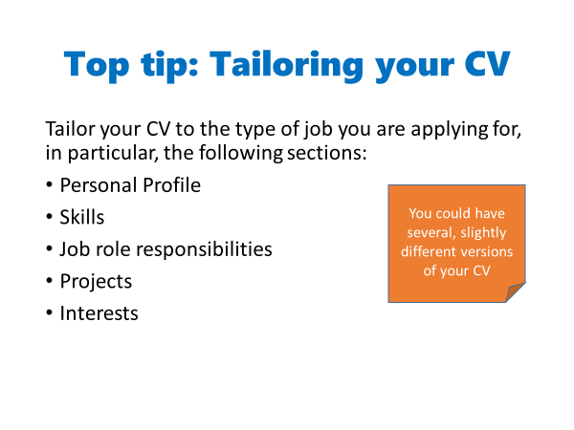

Slide 15
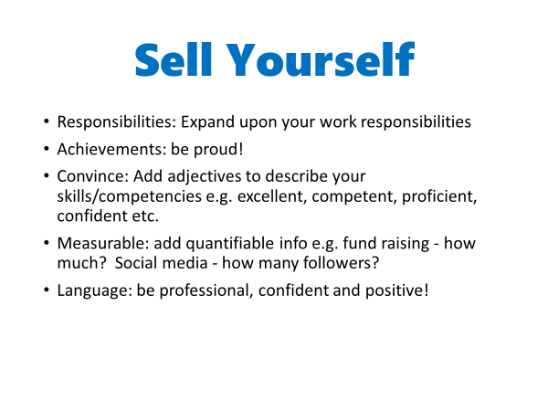

Slide 16
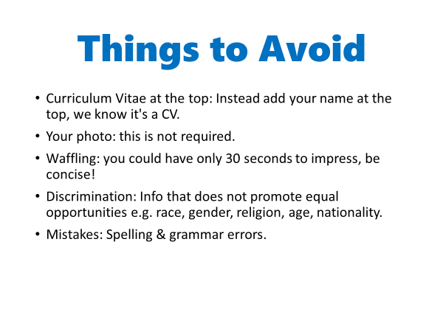

Slide 17

Some typical application processes…
CV only
CV & covering letter
Application form (online )
Application form & CV
Sometimes, employers will also ask you to provide a portfolio e.g. examples of your work.

Slide 18
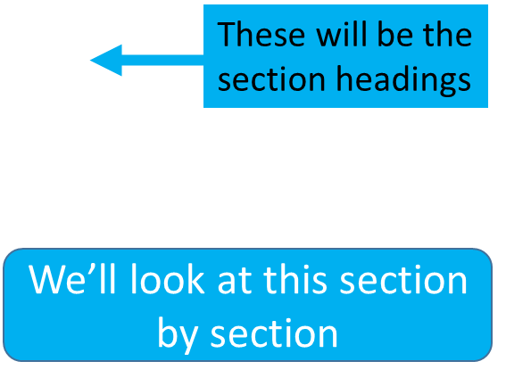
What to Include in Your CV
The Essential Information
1) Name & contact details
2) Education & qualifications
3) Employment History / Work Experience
4) Skills
5) References

Slide 19
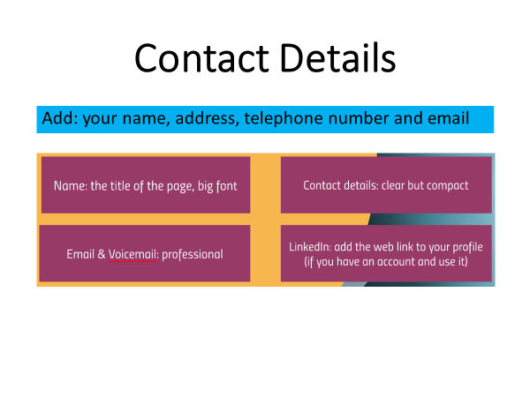

Slide 20
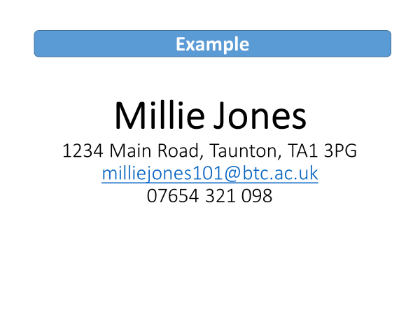

Slide 21
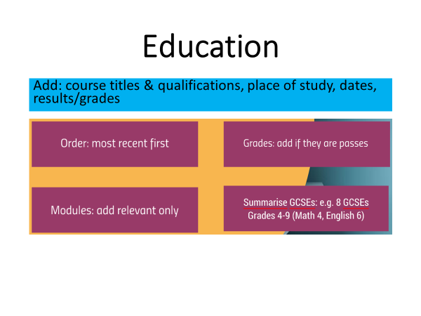

Slide 22
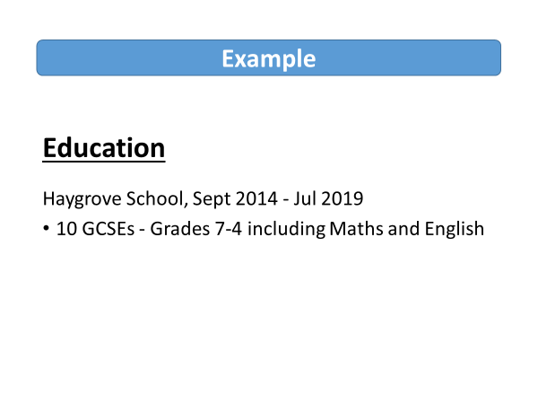

Slide 23
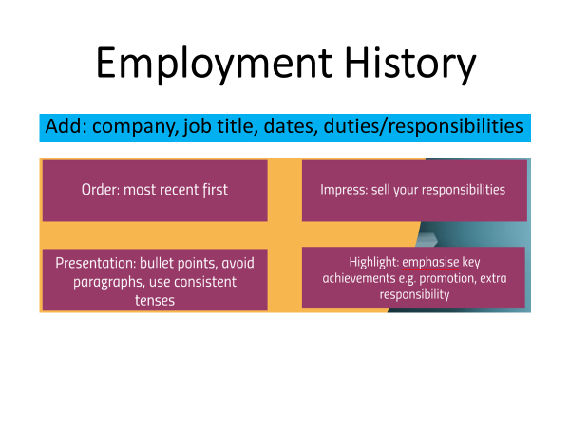

Slide 24
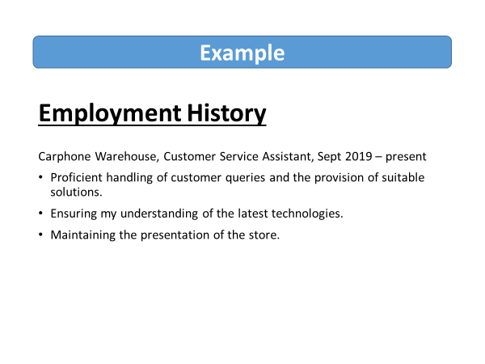

Slide 25
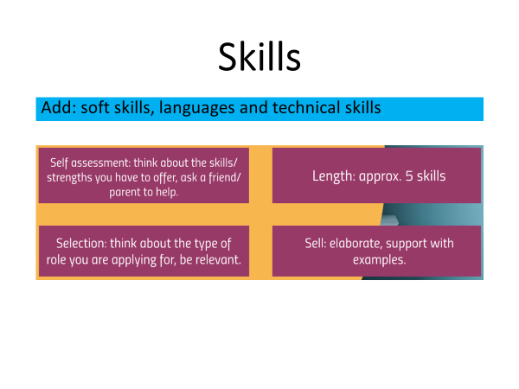

Slide 26
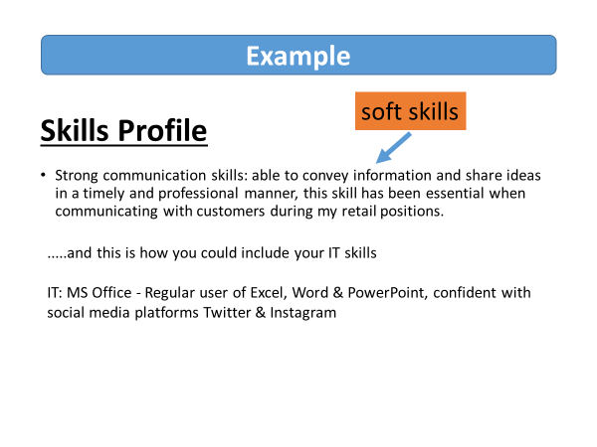

Slide 27
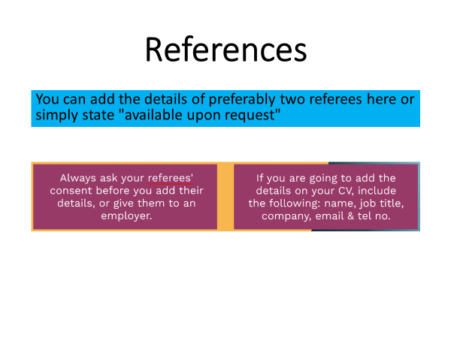

Slide 28
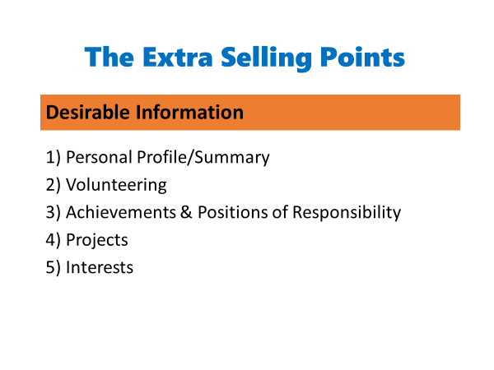

Slide 29
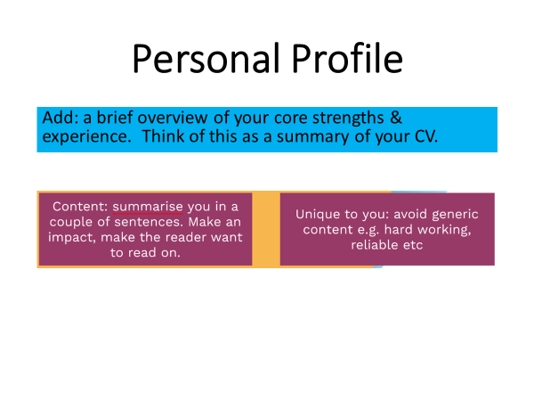

Slide 30
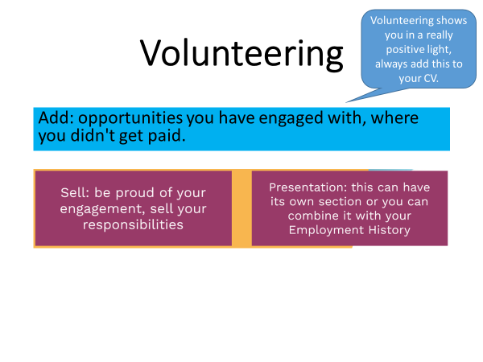

Slide 31
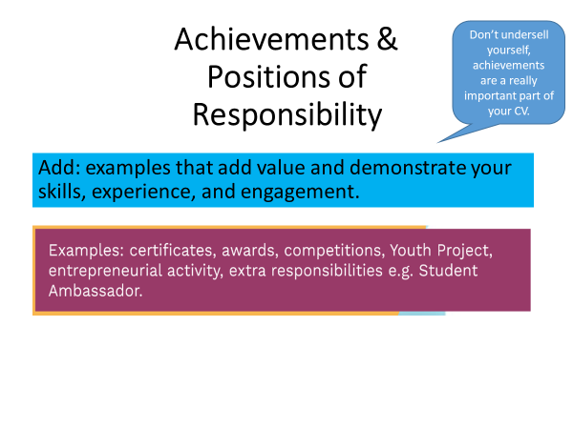

Slide 32
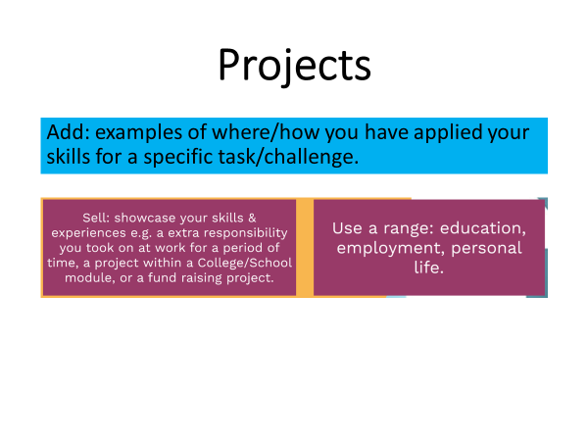

Slide 33
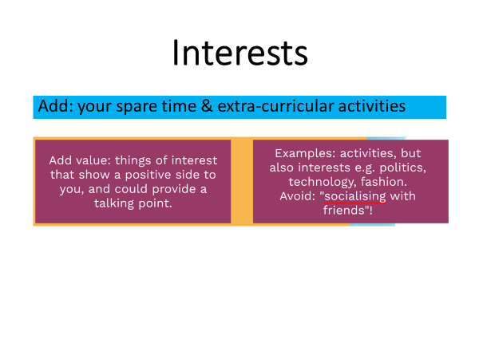

Slide 34
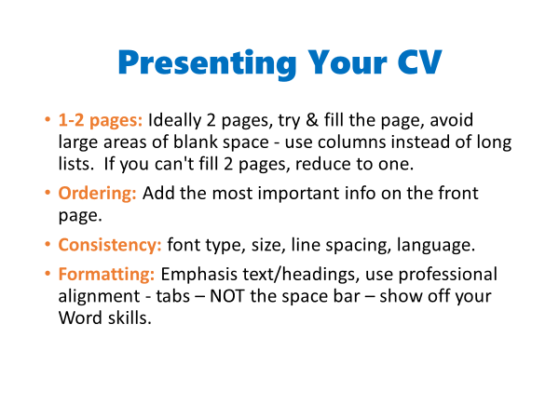

Slide 35
Activity: A Bad CV
Proof-read the CV for spelling and punctuation errors.
Proof-read the CV for spelling, punctuation and layout.
Can you find anything else wrong with the CV? What’s missing?
All: How could it be improved?
Notes:
List: https://docs.google.com/document/d/133bPw_uU6quyaCW0KUGYRqIV5XJPFbGr/edit?usp=sharing&ouid=107132437745420382364&rtpof=true&sd=true

Slide 36
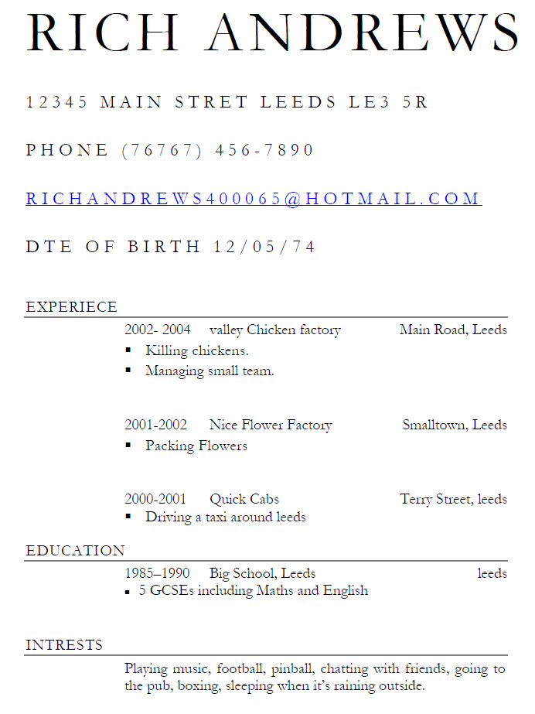
Answer the questions about Rich Andrews.
How old is he?
Where does he live?
What should you do if you want to contact him?
What was his first job?
What is his job now?
What are his duties in his job now?
What qualifications does he have?
When did he finish school?
Write down two of his hobbies.
Can you find any mistakes in this CV? Put a circle round any of the mistakes.

Slide 37
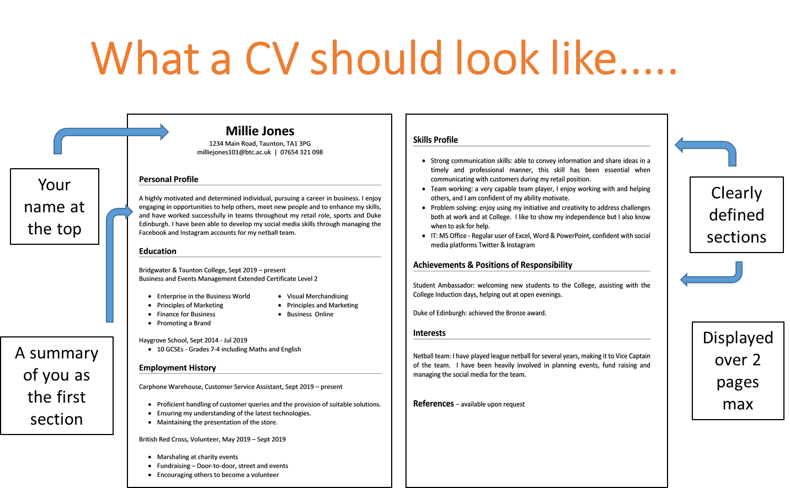

Slide 38
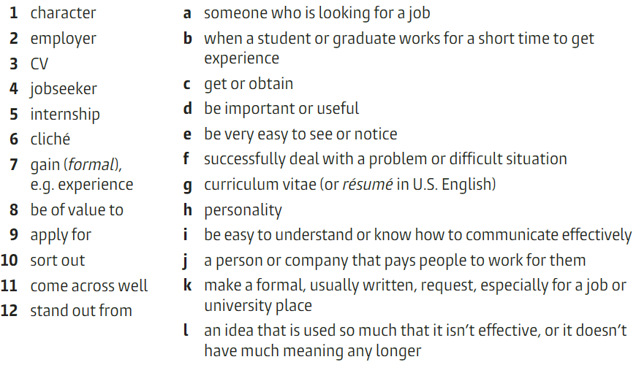
Vocabulary
Match the words with their definition.

Slide 39

How to Write a CV
Answer the pre-listening questions.
What do you take into account to write a CV?
What was a common mistake you made when writing a CV?

Slide 40

Discuss
Answer the following questions.
1. What is the average time recruiters spend reading a CV, and why is it crucial for job applicants to make their CVs stand out within this short time frame?
2. What are some common reasons for CV rejection mentioned in the video, and how can jobseekers avoid these pitfalls?
3. What are some key points mentioned for CV length, layout, and personal statement writing?
4. Why is it important for jobseekers to tailor their CVs to each specific job application, according to the video? How can they achieve this customization effectively?
5. In the section about education, what caution does the video give regarding embellishing qualifications on a CV? What are some acceptable ways to highlight educational achievements without misleading the recruiter?
Notes:
Answers to the comprehension questions:
1. Bob's main concern regarding robots and automation is that they will take over jobs, leading to unemployment and potentially causing societal upheaval.
2. The speaker counters Bob's concerns by pointing out that technological advancements have historically led to increased efficiency and prosperity, and that humans have adapted to these changes by learning new skills.
3. The speaker uses the example of the Industrial Revolution to illustrate the impact of technological advancements on employment, highlighting how automation has led to fewer people working fewer hours to achieve greater prosperity.
4. Some benefits of automation mentioned in the text include increased efficiency, reduced workload, and the ability to perform tasks that are difficult, dirty, dangerous, or time-consuming.
5. The speaker suggests that humans adapt to technological advancements by learning new skills and finding new opportunities, ultimately benefiting from having their previous jobs done by machines.

Slide 41
Understanding and analyzing job offers
Job Title and Description
Company Information
Required Skills and Experience
Responsibilities and Day-to-Day Activities
Compensation and Benefits

Slide 42
Understanding and analyzing job offers
Job Title and Description:
Read the job title and description carefully to understand the responsibilities, tasks, and requirements of the role.
Identify key technologies, tools, and skills mentioned in the job description and assess whether you possess them or are willing to acquire them.
Look for opportunities for career growth and development within the role.

Slide 43
Understanding and analyzing job offers
Job Title and Description:
Read the job title and description carefully to understand the responsibilities, tasks, and requirements of the role.
Identify key technologies, tools, and skills mentioned in the job description and assess whether you possess them or are willing to acquire them.
Look for opportunities for career growth and development within the role.

Slide 44
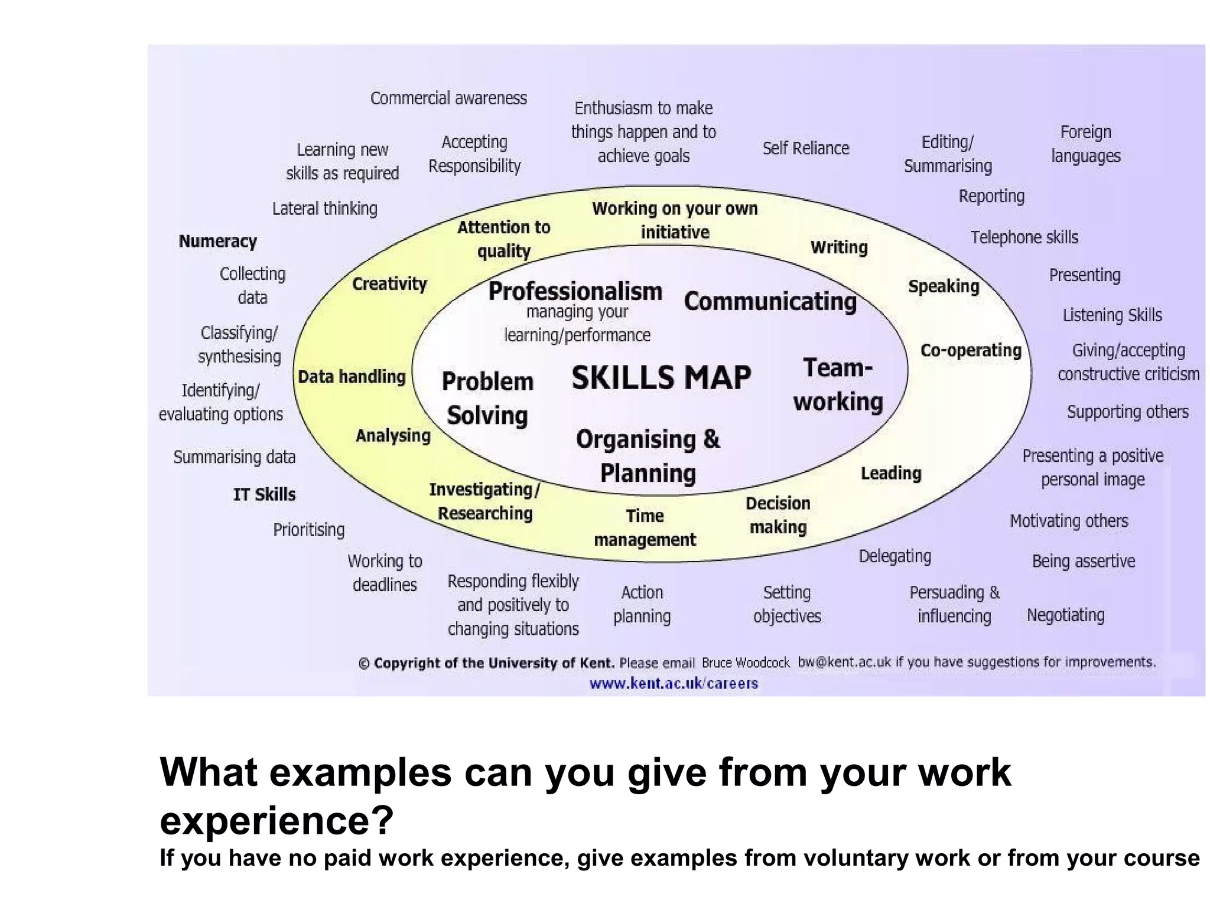

Slide 45
Write your CV
Choose a job offer from the list.
Create a CV taking into account all the tips provided during this class.
Present it to the class and explain why your CV can be successful in the selection process.
Notes:
List: https://docs.google.com/document/d/133bPw_uU6quyaCW0KUGYRqIV5XJPFbGr/edit?usp=sharing&ouid=107132437745420382364&rtpof=true&sd=true

Slide 46


